Slide 1
Exploring Semantic Link
Brent Meulebroeck

Slide 2
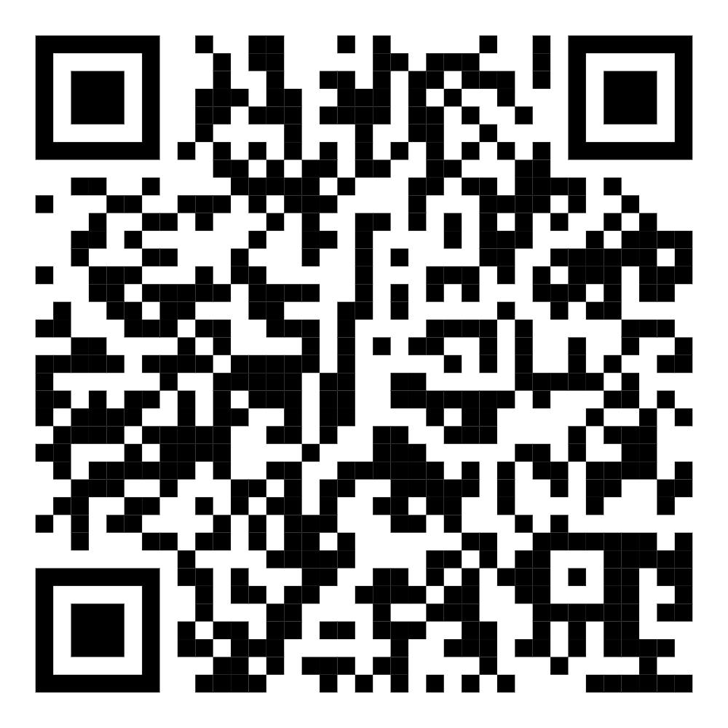

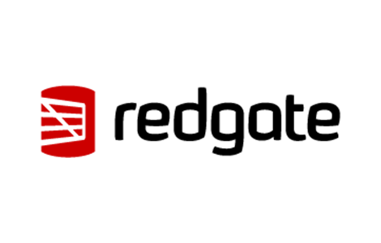
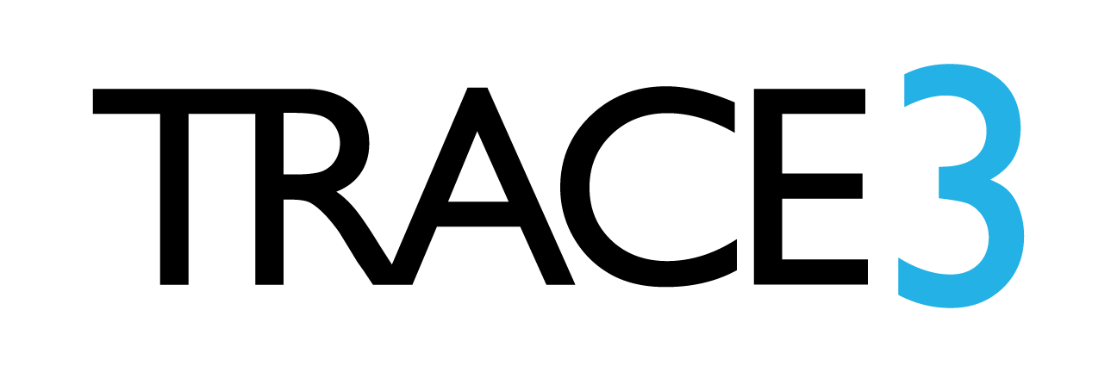


Visit the Sponsor Booths
Lots of Great Raffle Prizes!
Enter your details on Raffle Entry Form & visit Sponsors to fill in Bingo card for Raffle prizes
Thank you Sponsors!
Gold Sponsors:
Silver Sponsors:
Bronze Sponsors:
Blog Sponsors:
Notes:
Link to Raffle: https://forms.office.com/r/ZMSNL0Bbpp

Slide 3
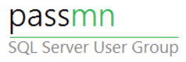
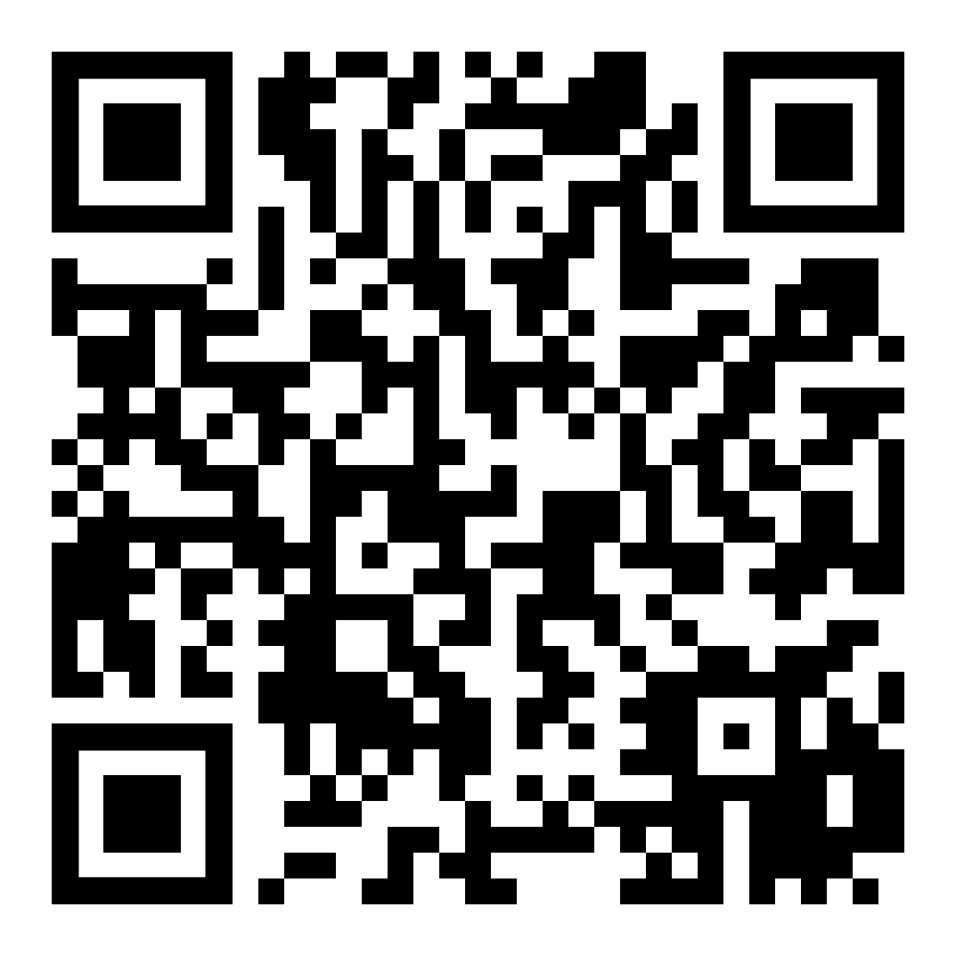
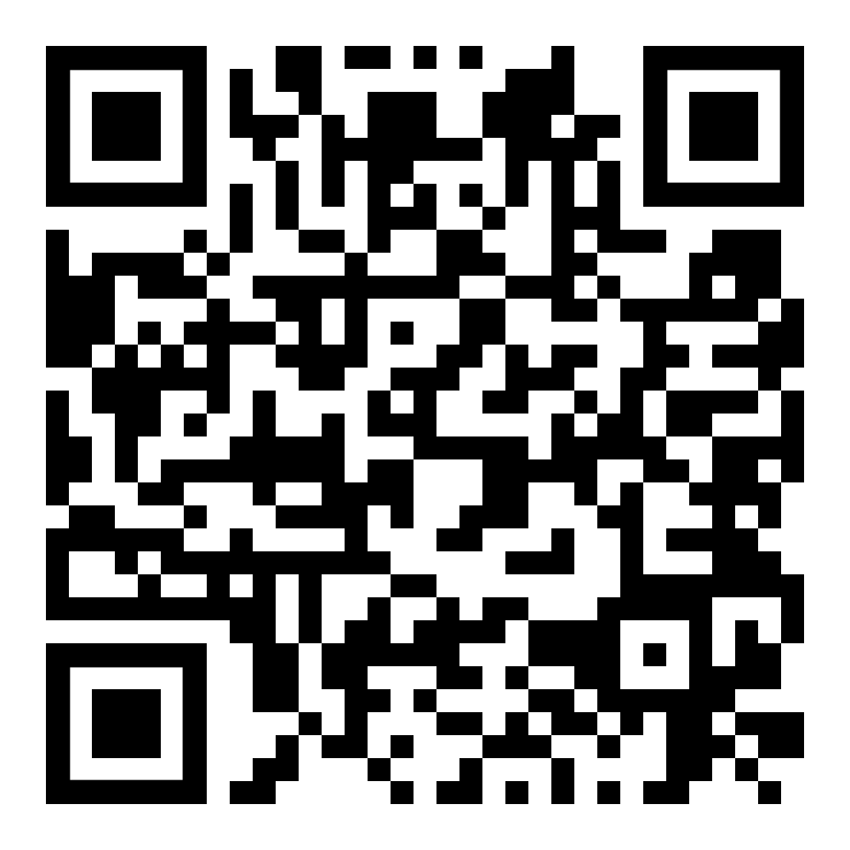
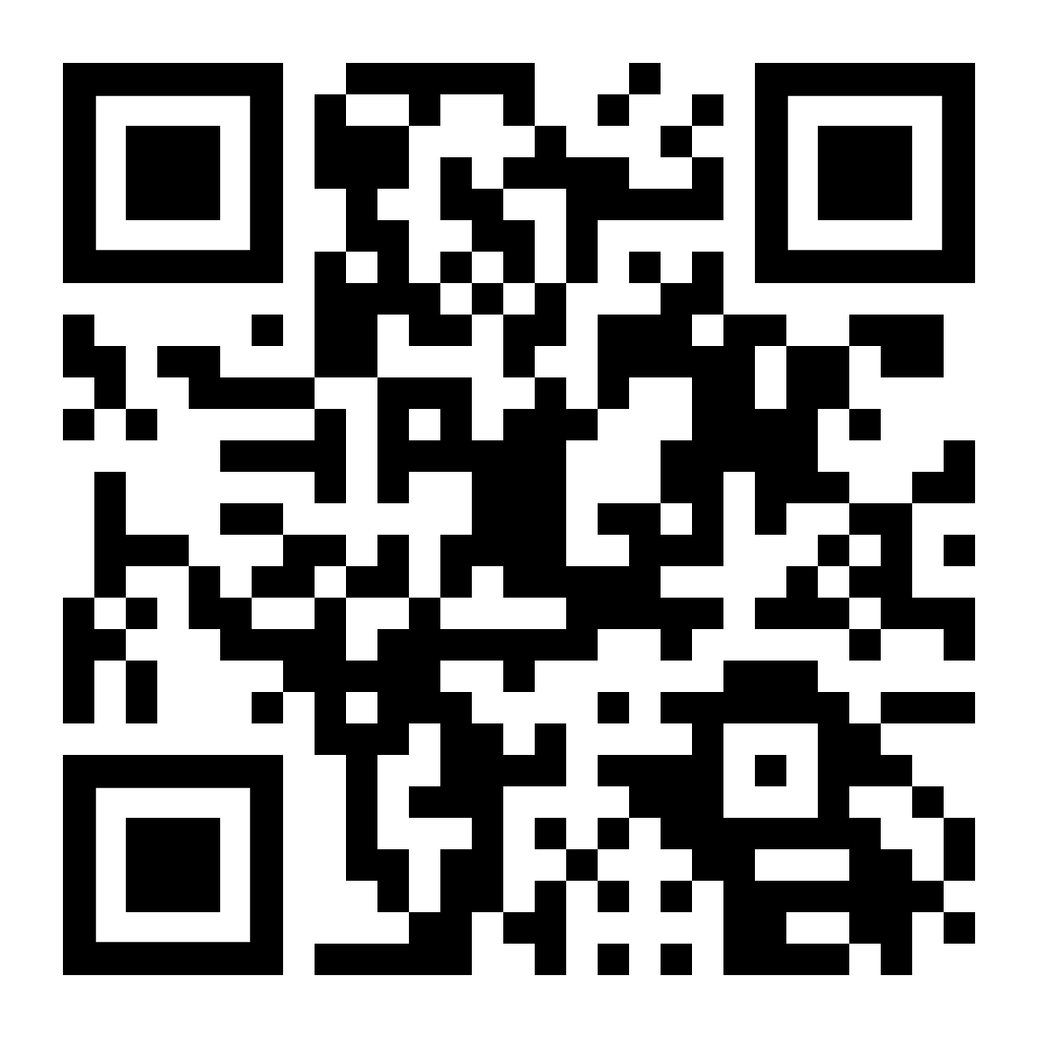
PASSMN – News/Info
Thanks to all our sponsors of 2024!
We need Speakers & Sponsors for 2025 PASSMN Meetings!
Sign up to present at one of the monthly meetings!
Monthly Meetup: 3rd Tuesday of Each Month
Signup on Meetup:
https://www.meetup.com/MN-SQL-Server-User-Group-PASSMN/
Board Member Elections in Q4:
Your chance to help the MN Data/SQL Community!
https://forms.office.com/r/rWfPhV6Chd

Slide 4
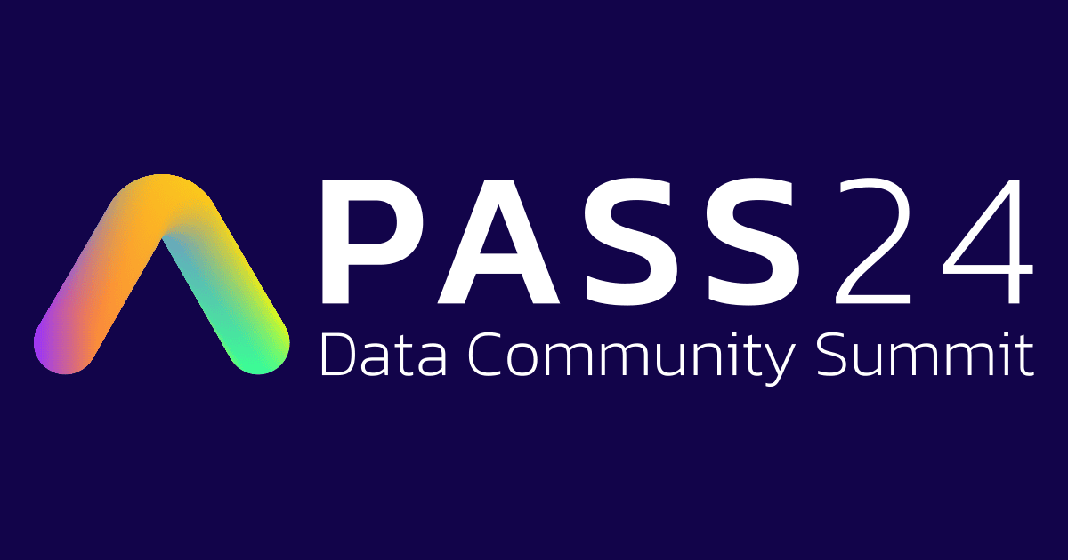
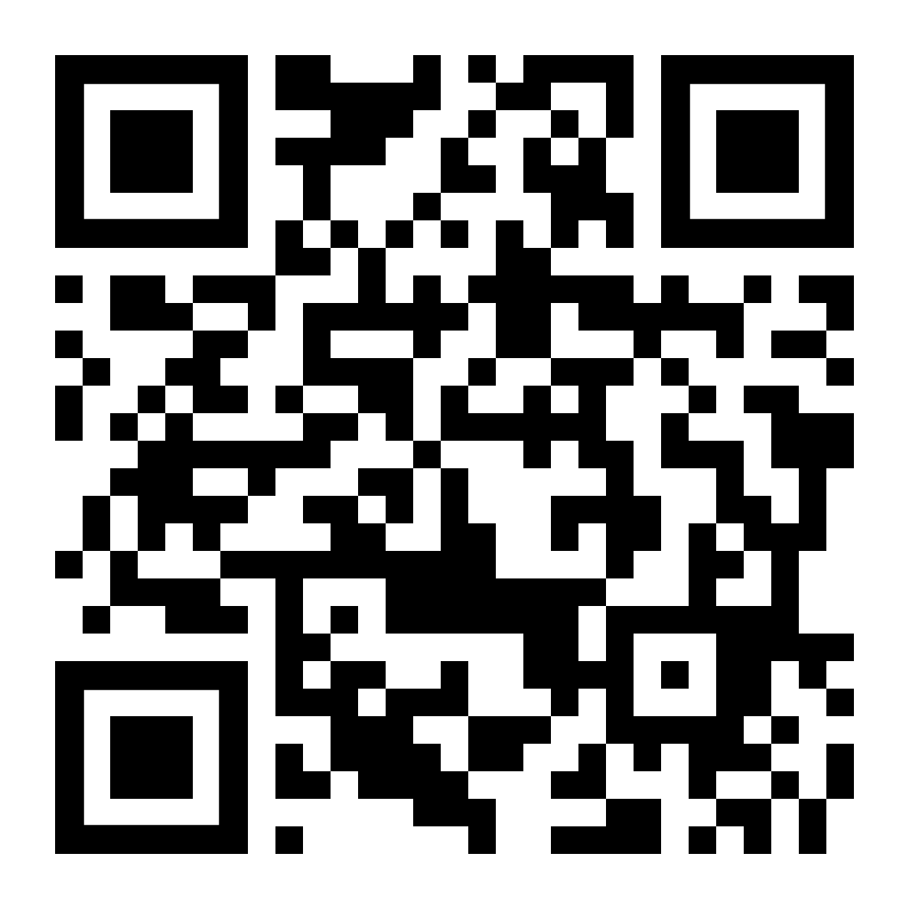
Connect, share, & learn with peers and thought leaders while celebrating all things data for a week of learning and networking opportunities.
November 4th Through November 8th in Seattle, WA
https://passdatacommunitysummit.com/

Slide 5
Semantic Link
Interact with your Semantic Models using the new Semantic Link Python library in Fabric

Slide 6
Agenda
How have we interacted with our models before
What is Semantic Link
Who will use Semantic Link
Demos and Use Cases
Extensions and advanced functionality
Resources and where to learn more

Slide 7



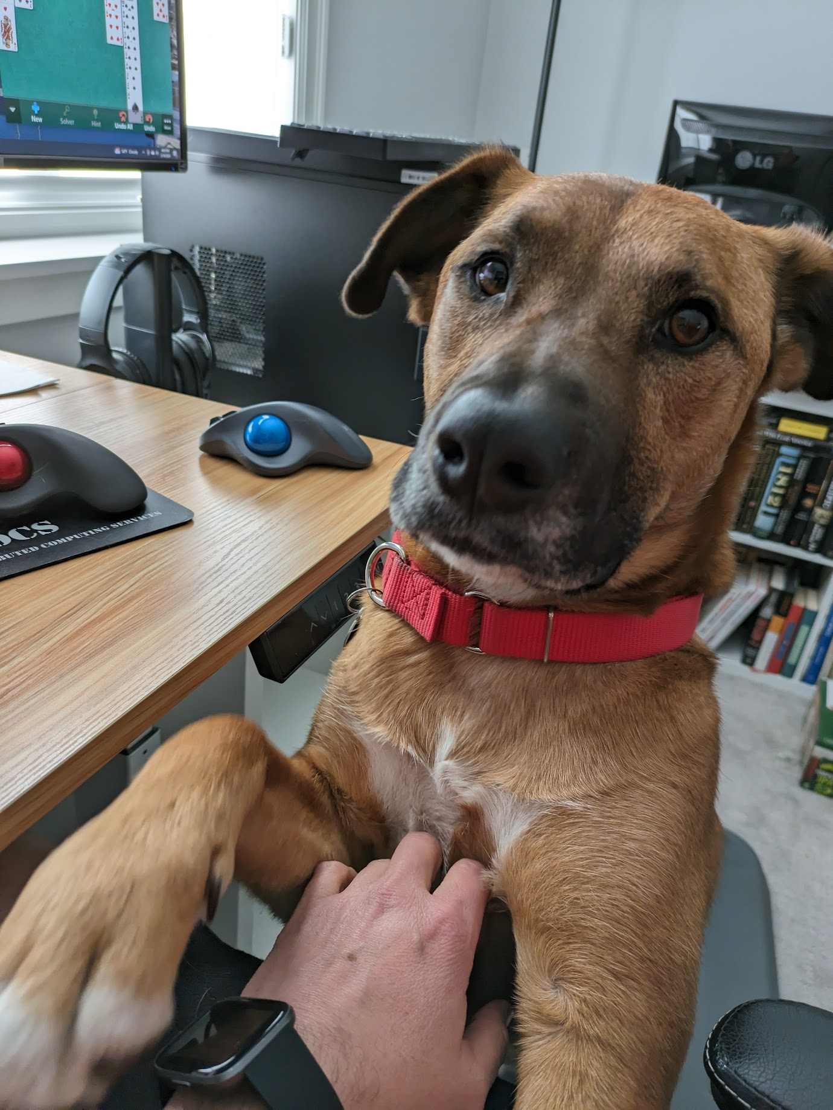

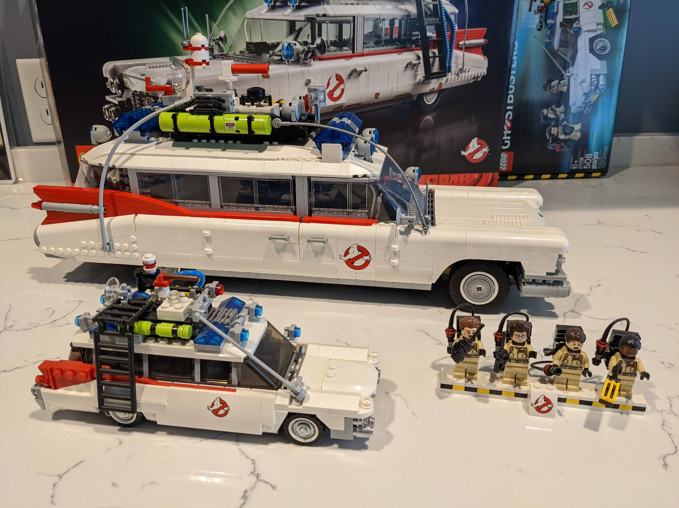
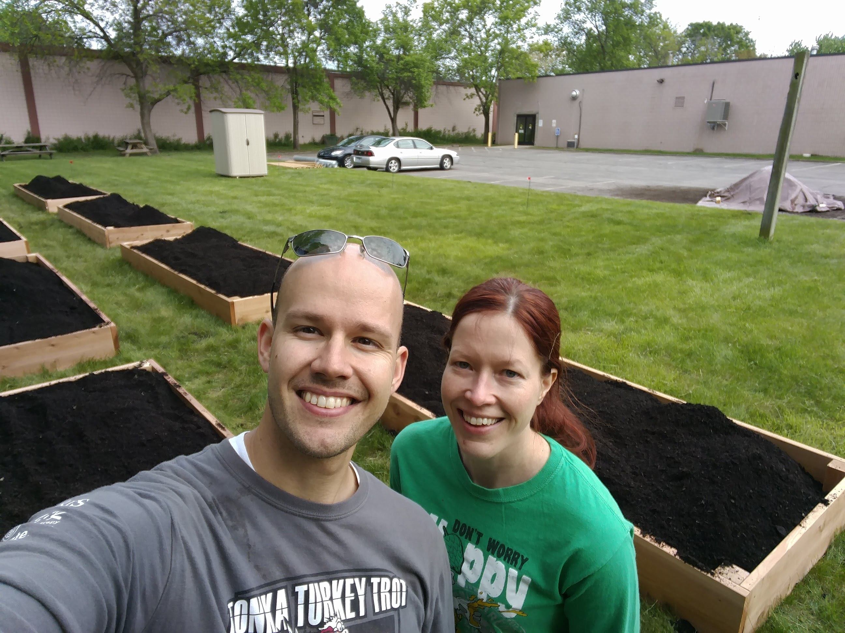

Brent Meulebroeck
Director Data Solutions
Hometown: Pipestone, MN
Graduated from MN State – Mankato
20 years in the retail world in a variety of store and field leadership roles with Target, Northern Brewer, and Goodwill-Easter Seals MN
Roles were always ‘data adjacent’ – developing KPIs, scorecards, etc. as tools for field leaders
The retail world shut down in March 2020 – time to pivot
Joined Fulton Analytics in 2021
Primarily back-end data engineering in the Microsoft Azure ecosystem and Power Platform (Power BI, PowerApps, and Power Automate), Microsoft Fabric practice lead
You can also find me:

Slide 8
Before Semantic Link…
Interacting with underlying model code has always been possible but with some hurdles
Third-party tools (DAX Studio, Tabular Editor, pbitools, etc.) were built to interface with the Analysis Services client libraries and make this a little easier
XMLA endpoint
Also via PowerShell and other tools
Notes:
Analysis Services had client libraries, which is what the third-party tools are using

Slide 9
What is Semantic Link
Semantic link allows you to connect to your semantic models via Notebooks in Fabric using the Python library SemPy
Via this connection you can extract information about your model, run queries against the model, access Fabric REST APIs, etc.
Output can be passed to other Fabric personas, or back into Lakehouse tables
All of this can be automated and scheduled
Authentication and security handled upstream (respects OLS/RLS)

Slide 10
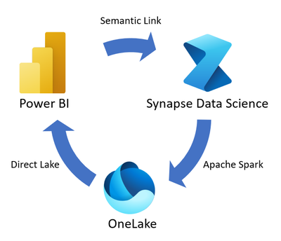
Semantic Link is the bridge between your semantic models and other Fabric Personas

Slide 11
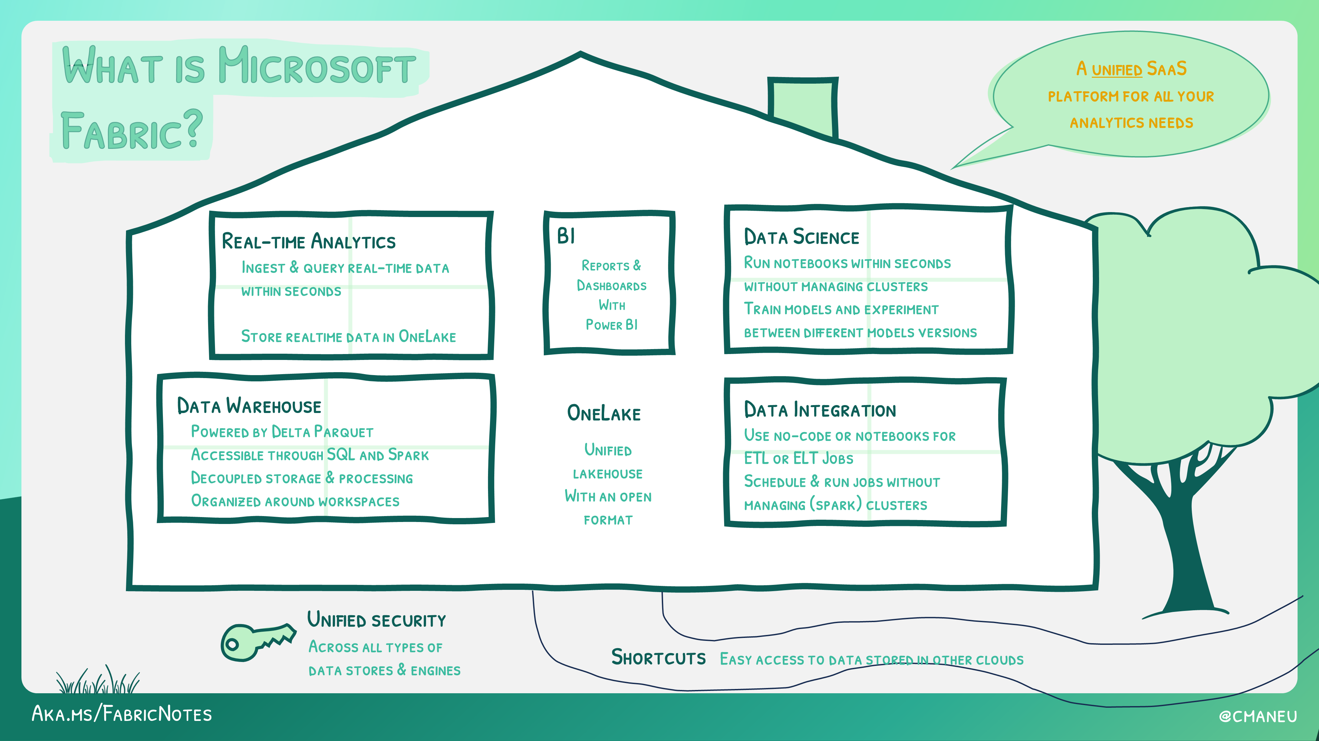

Slide 12


Fabric (and Semantic Link) is always evolving:
How it started…
…and where we’re headed

Slide 13
Who will use Semantic Link
Data Engineers
Extract model info, conduct data quality checks, monitor refreshes, etc.
Fabric Admins
Extract tenant information, monitor and update permissions and access rules
Data Analysts
Business logic and data validation, model maintenance/optimization (VPA,BPA)
Data Scientists
Access business logic and extract data from SMs for further analysis or modeling

Slide 14
Demos
Let’s take a look at Semantic Link in action!
But first – shout-outs:
I’m on the shoulders of giants in the community who have developed these resources and shared their time – please give them a follow and support:
Sandeep Pawar
Michael Kovalsky
Stephanie Bruno
Gilbert Quevauvilliers
Phil Seamark
Marcus Cozowicz
And many more I’m sure I’m forgetting

Slide 15
Demos

Slide 16
How to get started
Semantic Link is now installed in the default environment! Can just open a notebook, import sempy.fabric as fabric, and GO!
Semantic Link Labs is an extension that will need to be installed before use in each notebook
MS Learn has great tutorials (with pre-made notebooks) that you can just import and go, or customize to your use case
Connect to the community, check out YouTube

Slide 17
Resources to Learn More
Sandeep Pawar (@PawarBI, fabric.guru)
Michael Kovalsky (LI, GitHub)
MS Learn – Documentation and Example Notebooks

Slide 18
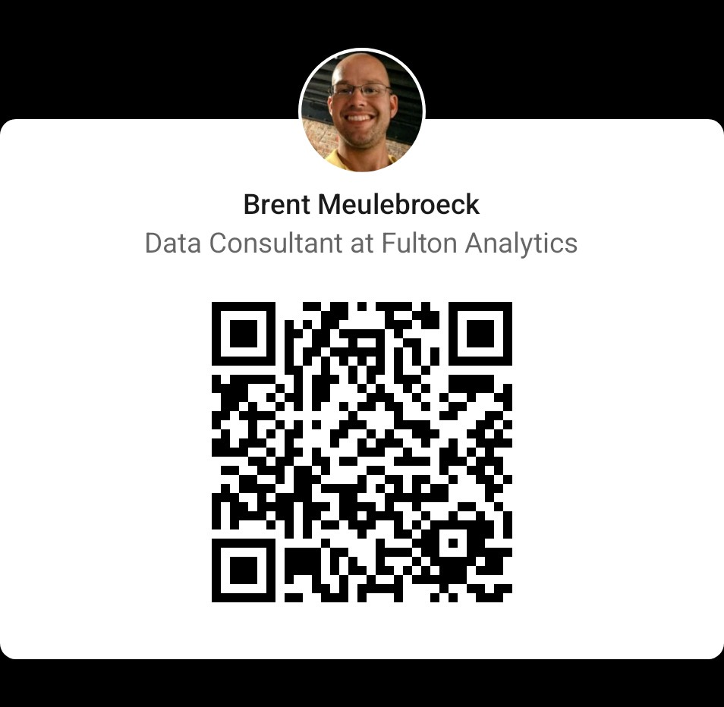
Thank You for coming!
Find me on LinkedIn:

